Slide 1
LEARNING TO PINPOINT SINGING VOICE FROM WEAKLY LABELED EXAMPLES
郑阳 2013013296
王旻晨 2013013302
王沁煜 2013013303

Slide 2
ABSTRCT
1
3
INTRODUCTION
RECIPE
Building an instrument detector is expensive to create. So we need a more efficient and simple method to fulfill this work.
A three-step training procedure that further improves results.
2
4
BASIC IDEA
EXPERIMENTS
Train a Convolutional Neural Network (CNN) on 10,000 30-second song snippets with sub-second granularity.
We train networks on a dataset of 10,000 weakly-annotated 30-second snippets, then evaluate them on two public datasets.

Slide 3
INTRODUCTION
Significance of the method
Annotated music pieces at high temporal accuracy are very important in instruments detecting, but it’s no easy to get.
Idea
Instrument annotations at a song level are often easily available online, the paper intend to obtain high-granularity vocal detection results from low-granularity annotations.
Techniques
Basic -> Convolutional Neural Network (CNN)
Improvement -> multiple-instance learning
saliency maps

Slide 4
INGREDIENTS
CNN-based Singing Voice Detection
基于卷积神经网络的歌声探测
Multiple-Instance Learning
多样例学习
Saliency Mapping
显著图

Slide 5
CNN-based Singing Voice Detection
Convolutional Neural Network (CNN) trained to predict whether a short spectrogram excerpt contains singing voice at its center.
Starts with 64 and 32 3×3 convolutions, 3×3 max-pooling, 128 and 64 3×3 convolutions.
Finish with three dense layers of 256, 64 and 1 unit, respectively.

Slide 6
Multiple-Instance Learning
A 30-second clip called bag is labeled positively if and only if at least one of the instances contained within are positive.
If a clip contains vocals, we only know that some excerpts will contain vocals, but neither which ones nor how many.
The mi-SVM algorithm uses the predictions of the initial classifier to re-label some instances from positive bags to become negative, and alternates between re-training and re-labeling until convergence.

Slide 7
Saliency Mapping
Guided backpropagation: At each layer, only propagate the positive gradient values to the previous layer.
The negative saliencies are not very useful: They form “halos” around the positive saliencies.
We keep the positive saliencies only.

Slide 8
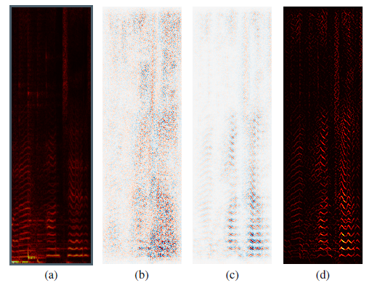
Saliency Map
Demonstration of saliency mapping: Network input
(a) gradient
(b) guided backpropagation
(c) and its positive values
(d) Best viewed on screen.

Slide 9
RECIPE
NAIVE TRAINNING
OVERSHOOT CORRECTION
SELF-IMPROVEMENT

Slide 10
RECIPE
Tried several variants of this idea:
Relabeling by thresholding the initial network’s predictions
Weighting positive examples by the initial network’s predictions
Removing positive examples the initial network is not confident about
NOT USEFUL(all methods above)
Training a second network to output the temporally smoothed predictions of the initial network for positive instances, and the actual labels for negative instances.
A third network to output the temporally smoothed summarized saliency maps of the second network for positive instances.

Slide 11
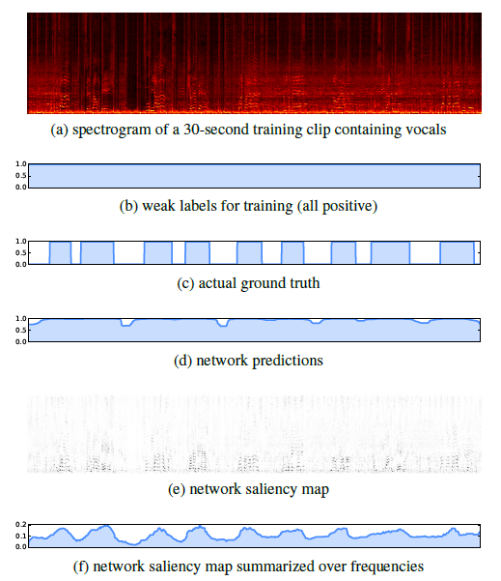
RECIPE
Network predictions
(d) overshoot vocal segments
(c) because input windows only partially containing vocals were always presented as positive examples
(b) Summarizing the saliency map
(e) over frequencies
(f) Allows to correct such overshoots.

Slide 12
EXPERIMENTS
For testing temporal detection
– RWC
– Jamendo
For spectral localization
– ccMixter
– MedleyDB
Notes:
Temporal detection（时间检测） 两个公开的数据集
Spectral localization（频谱定位） 两个公开的数据集

Slide 13
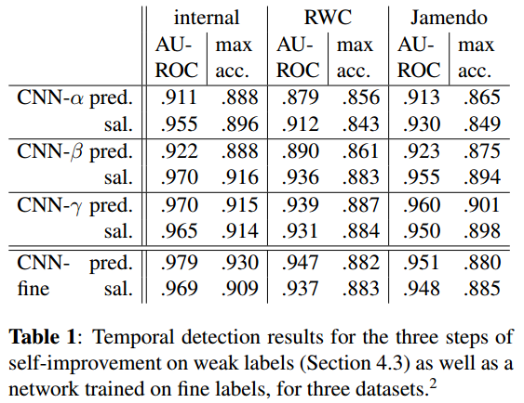
Temporal Detection Results
两个指标AUROC、max accurary
Notes:
两个标准AUROC、max accurary
Final是由Schlüter et al实现的结果
每次train都有所提升，且γ和final结果差不多

Slide 14
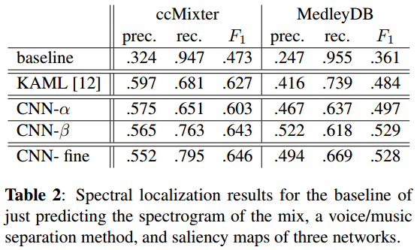
Spectral Localization Results
三个指标precision, recall and F1-measure
Notes:
定义了三个标准precision, recall and F1-measure
KAML是文中提到的一种实现
所有的方法和baseline都有很大的差距，CNN比KAML的F1要高，CNN-β已经接近了fine

